Slide 1
Company Bankruptcy Prediction Classification
Project 5 :
By – Ayush Meshram

Slide 2

Business Problem Statement
The prediction of bankruptcy is a phenomenon of increasing interest in firms that stand to lose money because of unpaid debts. Since computers can store huge data sets pertaining to bankruptcy, making accurate predictions from them beforehand is becoming important. Company bankruptcy was defined based on the business regulations of the Netherlands (Financial Institution) in this project you will use various classification algorithms on the bankruptcy dataset to predict bankruptcies with satisfying accuracies long before the actual event.

Slide 3
PRIMARY GOAL:
This exercise aims to build a model, using historical data that will determine the prediction of bankruptcy.

Slide 4
A glance at data

Slide 5
Exploratory Data Analysis
Basic EDA -
Data Shape: ( 6819 rows,95 columns).
All Numerical(int64&float64) columns: (95).
Independent Variables/Features – 94 columns.
Dependent variable/Feature- 1 (‘Bankrupt’).
Problem – Classification(Binary).
Null values present percentage in data = 0%.

Slide 6
Analyzing data and acquiring insights
After carefully observing , analyzing and plotting (pair-wise plotting) the variables with one and another to better understand the underlying relationship of features with one and another . We got some significant information about the features indicating that those features may playing a significant role in determining or identifying a Firm as Bankrupt.
Those features are – [ ' ROA(C) before interest and depreciation before interest’ ,' ROA(A) before interest and % after tax', ' ROA(B) before interest and depreciation after tax’,' Net Value Per Share (C)',' Persistent EPS in the Last Four Seasons’, ' Debt ratio %',' Net worth/Assets',' Net Income to Total Assets']

Slide 7
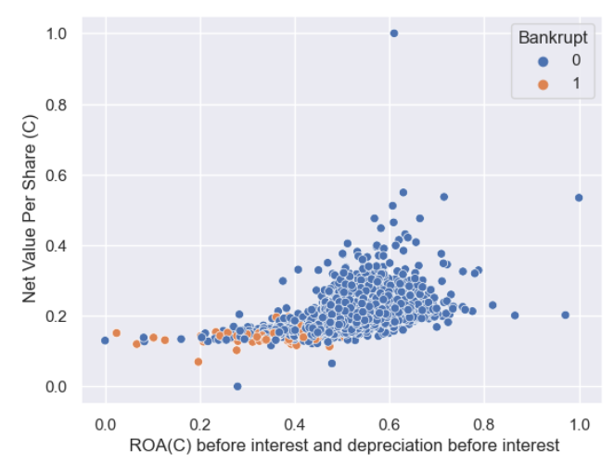
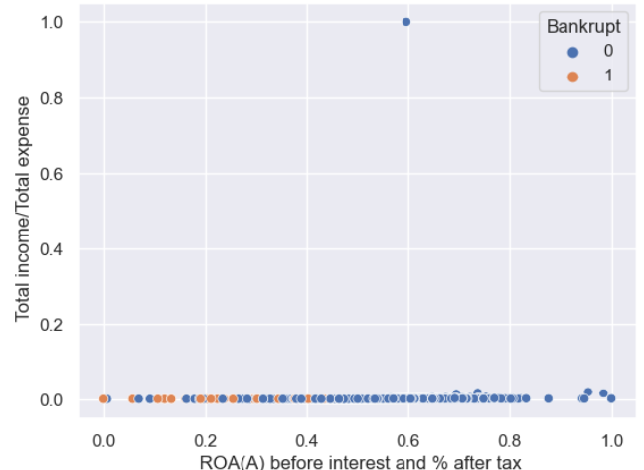
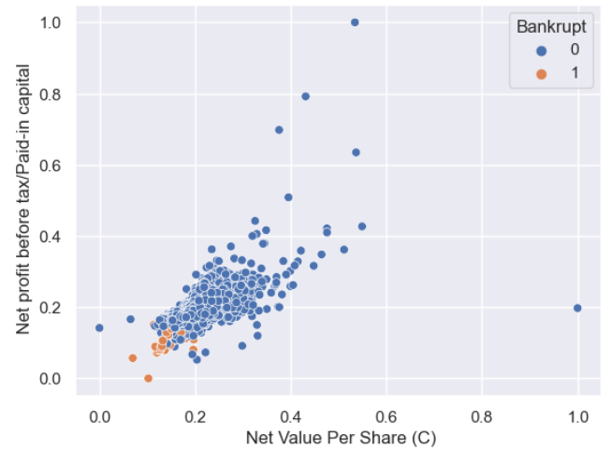
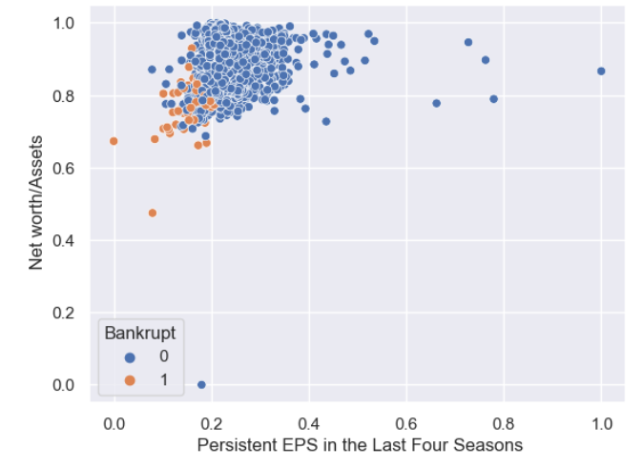
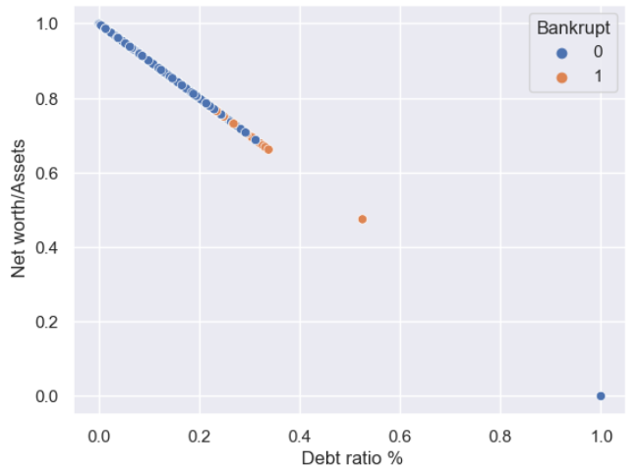
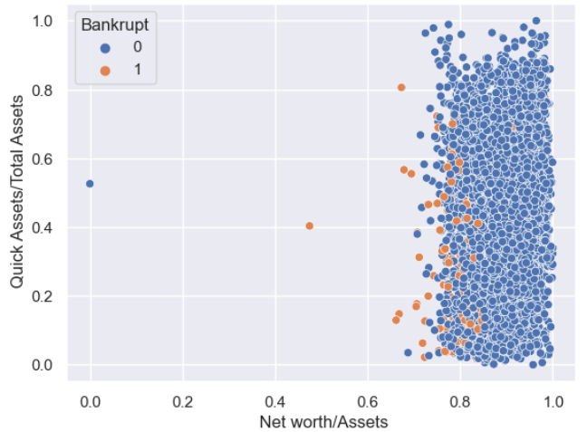
Sample scatterplots

Slide 8
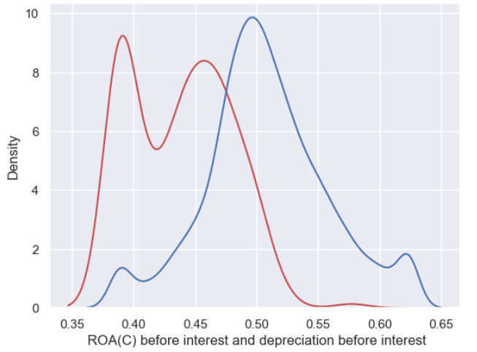
Specifically, out of the total of 220 bankrupt companies, 167 of them have ROA(C) values below 25%(which is < 0.47) of the average, indicating a higher likelihood of bankruptcy for companies with lower values of column ROA(C). On the other hand, out of the total of 6600 non-bankrupt banks, 1217 of them have column ROA(C) values below 25% of the average, suggesting that a smaller proportion(18%) of non-bankrupt firms also have lower values of column ROA(C).
This could potentially indicate that firms with lower values of column ROA(C) are more likely to face financial distress or bankruptcy, but there may still be a considerable number of non-bankrupt firms with low values of column ROA(C). It suggests that the value of column ROA(C) may be an important predictor or indicator of the financial health of a company.
when ' ROA(C) before interest and depreciation before interest' value for a bank is below 25% of avg value with respect to others, we got 167 firms which were classified as bankrupt which is 75.91% of total bankrupt firms and when its below mean 0.5051 the percentage is 95.45%

Slide 9
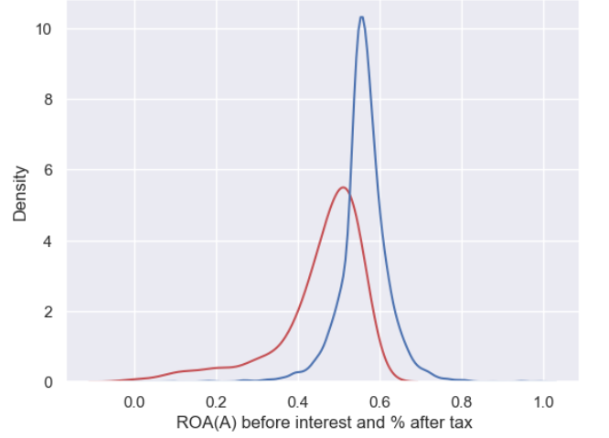
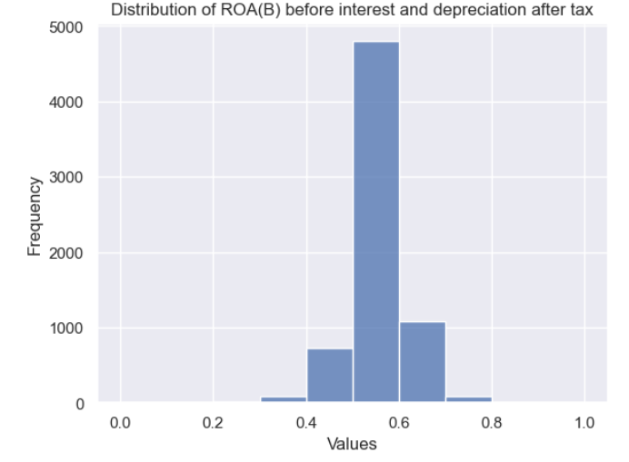
Similarly, when ' ROA(A) before interest and % after tax' value for a firm is below 25%(which is < 0.53) of avg value with respect to others, we got 168 firms which were classified as bankrupt which is 76.31% of total bankrupt firms.

Slide 10
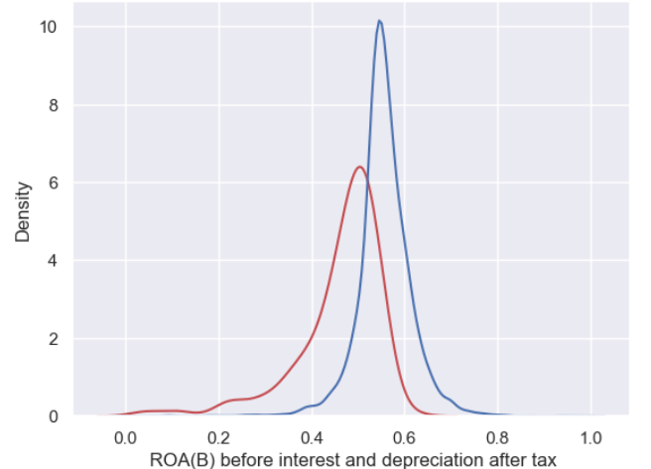
when ' ROA(B) before interest and % after tax' value for a bank is below 25% of avg value with respect to others, we got 167 firms which were classified as bankrupt which is 75.91% of total bankrupt firms and 1187 firms labeled as non-bankrupt(which is 17%).

Slide 11
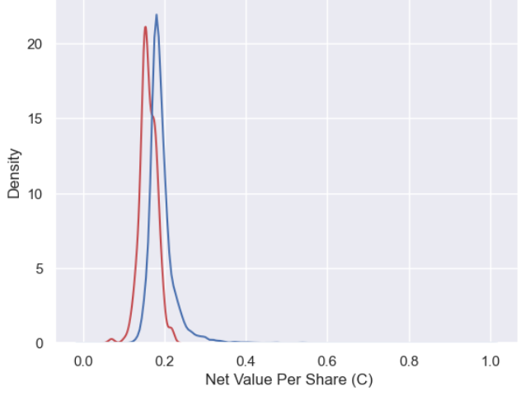
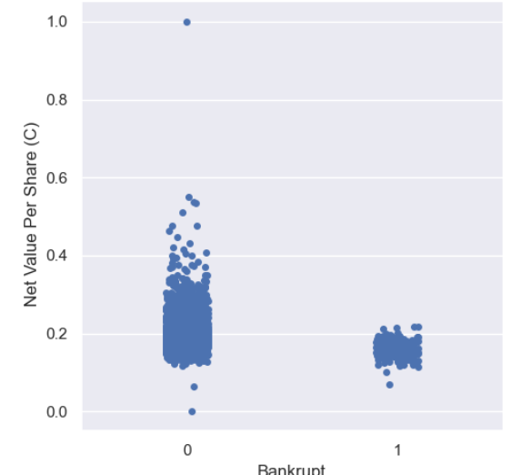
The feature ' Net Value Per Share (C)' value for a firm is when below 25% of avg value(0.18) with respect to others, we got 184 firms which were classified as bankrupt which is 83.64% of total bankrupt firms.

Slide 12
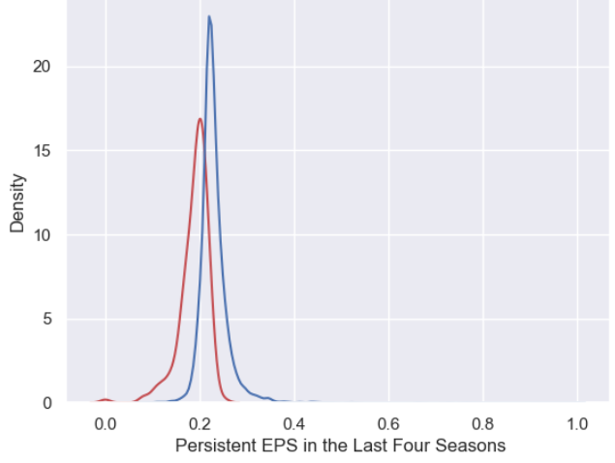
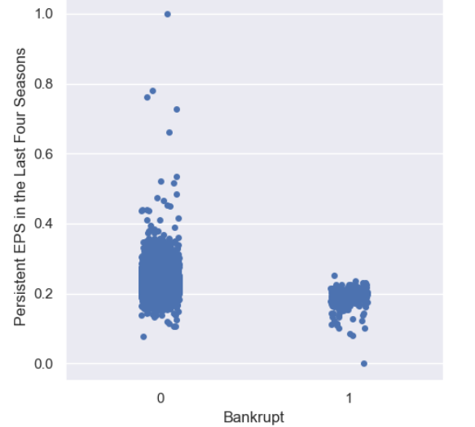
When ' Persistent EPS in the Last Four Seasons' value for a firm is below 25% of avg value(which is 0.21) with respect to others, we got 170 firms which were classified as bankrupt which is 77.27% of total bankrupt firms and 1089 firms labeled as non-bankrupt(which is 16%).

Slide 13
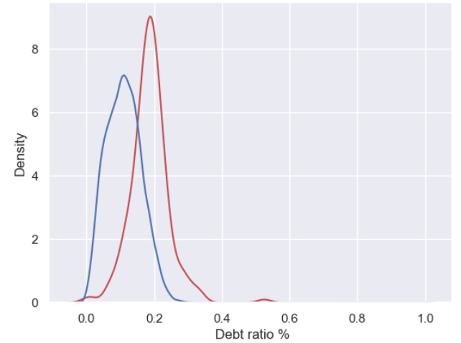
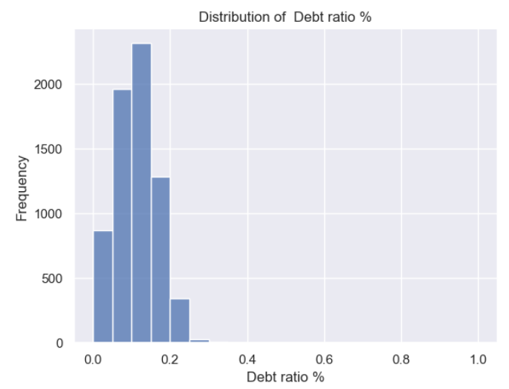
The insight obtained from the given information is that a significant proportion of bankrupt firms(177 out of 220 = 80.45%) have a debt ratio% of 0.15 or higher, while a smaller proportion of non-bankrupt firms also have a debt ratio of 0.15 or higher. out of the total of 220 bankrupt firms, 177 of them have a debt ratio of 0.15 or higher, indicating a higher likelihood of bankruptcy for firms with higher debt ratios. On the other hand, out of the total of 6600 non-bankrupt firms, 1491 of them have a debt ratio of 0.15 or higher, suggesting that a smaller proportion of non-bankrupt firms also have higher debt ratios.

Slide 14
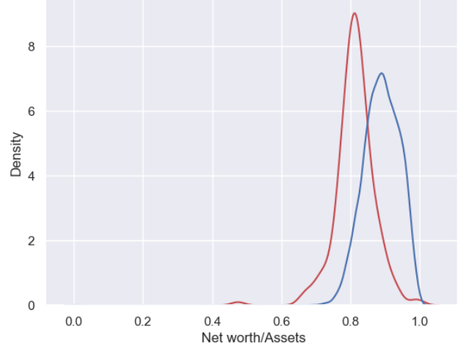
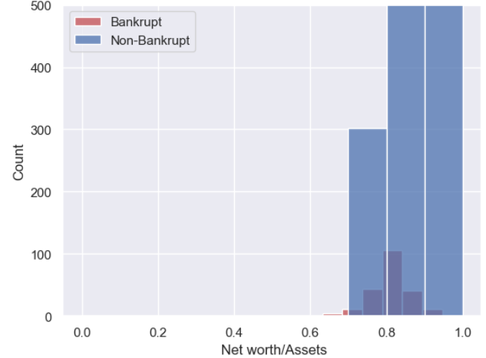
Having ' Net worth/Assets’ and ' Net Income to Total Assets’ values lower then 25% increases the chances of bankruptcy to 75% , from the given data.

Slide 15
Further EDA…
Analyzed data for outliers via Boxplot and capped the outlier data to upper and lower limits (i.e - upper_limit = q3 + (1.5 * iqr) &lower_limit = q1 - (1.5 * iqr))
Plotted distribution of variables via displot, to discovered and mitigate skewness in columns .
Used yeojohnson transformation technique which is very similar to Box-cox transformation but does not require the values to be strictly positive.

Slide 16
Feature Importance
Importance Features :
Non- Important Features:
[' Persistent EPS in the Last Four Seasons', 0.13996617],
[' Borrowing dependency', 0.032483168]
[' Net Income to Total Assets', 0.027979905]
[' ROA(B) before interest and depreciation after tax', 0.026976643],
[' Retained Earnings to Total Assets’,
0.026628593]
[' Debt ratio %', 0.021949217]
[' After-tax net Interest Rate’,0.02073966],
[' Current Asset Turnover Rate', 0.018880637]
[' Fixed Assets Turnover Frequency', 0.017630497]
[' Current Liability to Equity',' Interest-bearing debt interest rate', ' Accounts Receivable Turnover', ' Long-term Liability to Current Assets', ' Average Collection Days', ' Net Value Growth Rate', ' Quick Assets/Current Liability', ' Liability-Assets Flag',' Cash/Current Liability', ' Total assets to GNP price',' Current Ratio', ' Net worth/Assets', ' Revenue per person',' Quick Ratio’,' Allocation rate per person',' Current Liability to Liability’,' Equity to Liability’] = 0

Slide 17
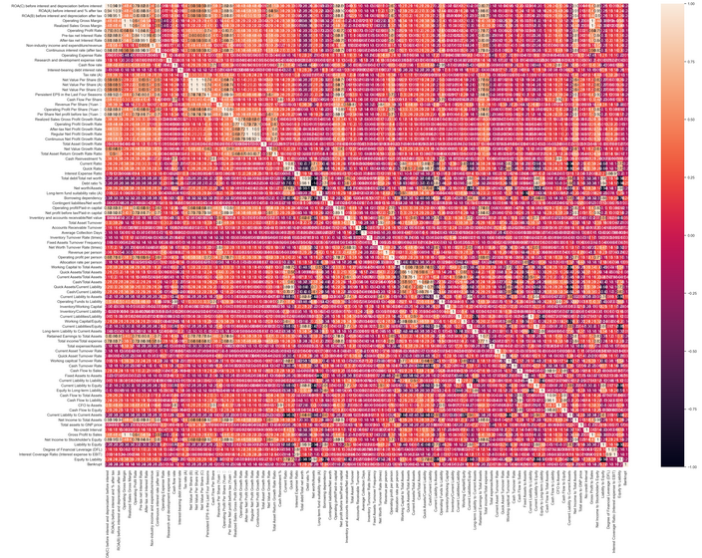
CORRELATION MATRIX

Slide 18
CORRELATION& other FINDINGS
Out of 94 independent features ,55 are highly correlated with one and another .
All features are in low correlation with target column (lesser then 0.4 majority).
Imbalance in Target column (0 class is 97% and 1 class is only 3%).
We used Synthetic Minority Oversampling Technique or SMOTE technique to oversample the minority class. new instances are synthesized from the existing data. If we explain it in simple words, SMOTE looks into minority class instances and use k nearest neighbor to select a random nearest neighbor, and a synthetic instance is created randomly in feature space.

Slide 19
DimenSionALITY REDUCTION
As we seen there are 55 highly correlated features in our data as highly correlated features can lead to multicollinearity issues, which can affect the performance of the model and make it difficult to interpret the importance of individual features. but , dropping them straight may not be a good idea too.
So , we can use methods like correlation analysis or dimensionality reduction techniques like PCA to Reduce the dimensions and identify the most important features in your dataset. Correlation analysis can help identify the pairs of highly correlated features, while PCA can help identify the principal components that capture the most variance in your dataset.
Ultimately, the goal of using principal component analysis is to reduce the dimensionality of the data while retaining as much information as possible.

Slide 20
MODEL BUILDING
XG BOOST
LOGISTIC REGRESSION
Sample mean accuracy given by k-fold validation: 0.969
Train & test accuracy: 0.99 & 0.96
precision recall f1-score
0 0.99 0.93 0.96
1 0.94 0.99 0.96
Trained model with GridSearchCv for best parameters ('booster': 'gbtree', 'gamma': 0, 'learning_rate': 0.5, 'n_estimators': 150 ).
Sample mean accuracy given by k-fold validation: 0.882
Train & test accuracy: 0.883 & 0.884
precision recall f1-score
0 0.90 0.86 0.88
1 0.87 0.91 0.89

Slide 21
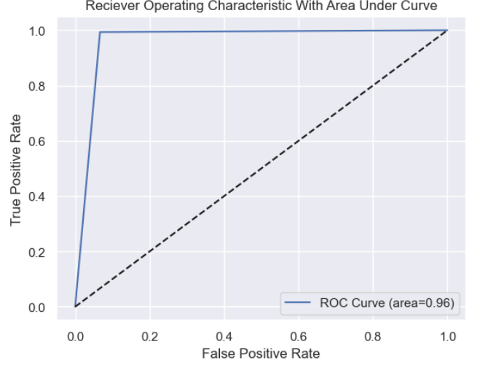
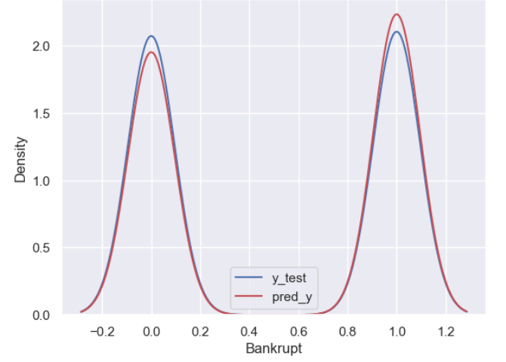
Y_TEST VS Y_PREDICT
AUC-ROC CURVE

Slide 22
BUSINESS OPPORTUNITIES ARE LIKE BUSES. THERE'S ALWAYS ANOTHER ONE COMING.
“
”
Richard Branson

Slide 23
THANK YOU

